Slide 1
6 Repetition Structures(1) (Midterm Test)
Instructor: Raed Karim
Email: raed.karim@sheridancollege.ca
Course: PROG12583

Slide 2
Repetition Structures
Objectives
At the end of this module, students will be able to:
Write pseudocode to design repetition structures.
Analyze and implement condition-controlled repetition structures (while loops).
Construct repetition structures (loops) as part of their programs.
Solve problems by writing code with repetition structures.

Slide 3
Writing pseudocode for repetition structures (loops) Part - 1

Slide 4
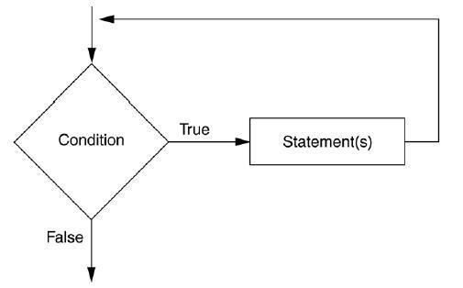
Repetition Structures
Repetition Structures
A repetition structure causes a statement or set of statements to execute repeatedly
Allow a programmer to avoid duplicate code
Duplicate code makes a program large
Write a long sequence of statements is time consuming
If part of the duplicate code must be corrected or changed, then the change must be done many times

Slide 5
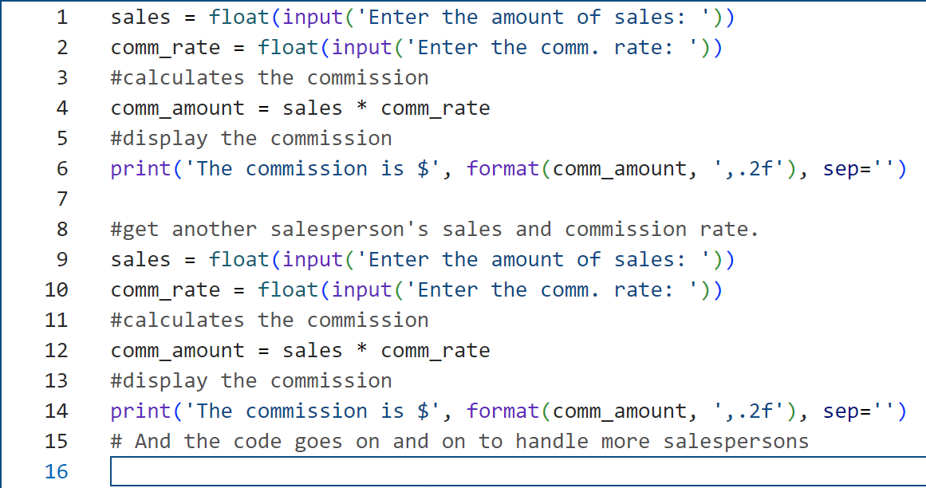
Repetition Structures
Repetition Structures
For example, suppose you have been asked to write a program that calculates a 10 percent sales commission for several sales people.
Although it would not be a good design, one approach would be to write the code to calculate one salesperson’s commission, and then repeat that code for each salesperson. For example, look at the following code:
This code contains lots of duplications and can be too long!

Slide 6
Repetition Structures
Repetition Structures
As you can see, this code is one long sequence structure containing a lot of duplicated code. There are several disadvantages, the ones discussed in slide 4.
Instead of writing the same sequence of statements over and over, a better way to repeatedly perform an operation is to write the code for the operation once, then place that code in a structure that makes the computer repeat it as many times as necessary.
This can be done with a repetition structure, which is more commonly known as a loop.

Slide 7
Repetition Structures
Repetition Structures
Two broad categories of loops:
A condition-controlled loop uses a true/false condition to control the number of times that it repeats. Since a while loop uses a condition to determine the number of times it executes, it is known as a condition-controlled loop.
A count-controlled loop repeats a specific number of times. Since for loop executes once for each item in a collection, it’s known as a collection-controlled or count-controlled loop.

Slide 8
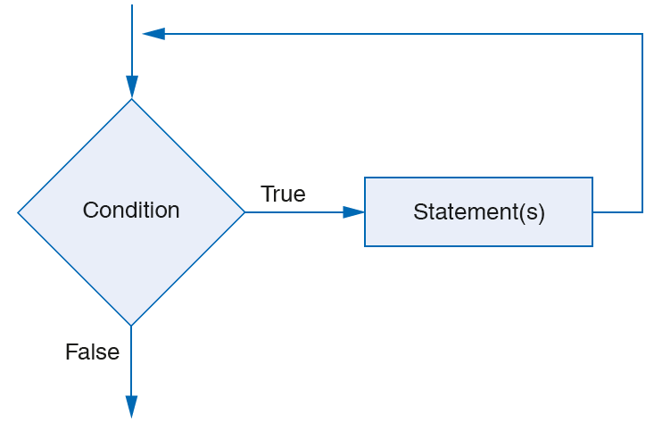
Repetition Structures
Repetition Structures: pseudocode and flowchart
The While Loop
While condition
Statement
Statement
Etc…
End While

Slide 9
Repetition Structures
Repetition Structures: pseudocode and flowchart
The While Loop: a pseudocode example
Declare Integer count = 0
While count < 10
Display count
Set count = count + 1
End While

Slide 10
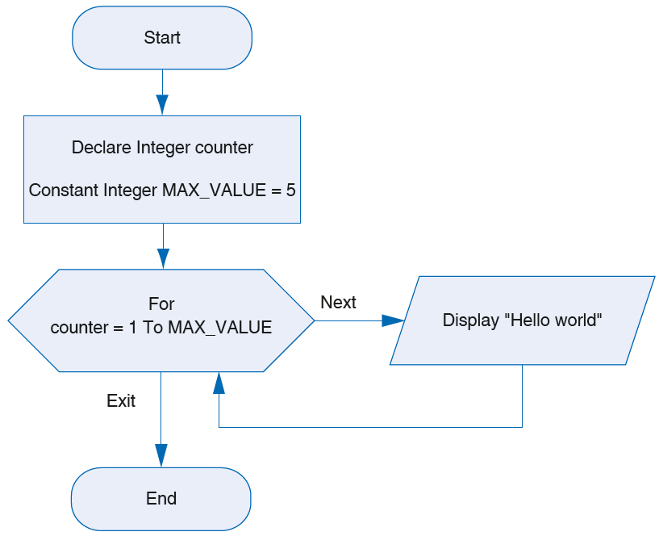
Repetition Structures
Repetition Structures: pseudocode and flowchart
The FOR Loop
for variable in [value1, value2, etc.]:
statement
statement
etc.

Slide 11
Repetition Structures
Repetition Structures: pseudocode and flowchart
The FOR Loop: a pseudocode example
Example of the for Loop
for num in [1, 2, 3, 4, 5]:
print(num)

Slide 12
Repetition Structures
Repetition Structures: while Loop
The Python’s syntax of the while statement that’s used to create while loops:
General Format of the while Loop
while condition:
statement
statement
etc.
Example:
count = 0
while count < 5:
print('Hello')
count = count + 1

Slide 13
Repetition Structures
Repetition Structures: while Loop
This statement starts with the while keyword followed by a Boolean expression and a colon. Then, an indented block of one or more statements starts on the next line. These are the statements in the loop, and they end when the indentation ends.
When Python executes a while statement, it executes the statements in the loop while the Boolean expression evaluates to True. Since a while loop uses a condition to determine the number of times it executes, it is known as a condition-controlled loop.

Slide 14
Repetition Structures
Repetition Structures: while Loop
When writing a loop, in most case, we want to keep track the number of times the task is repeated or (the number of iterations that occur). This process is very important when solving problems.
For this purpose, we can define a counter. It is a variable that we initialize (usually to the value of zero) before starting a loop. Then inside the loop, we increment it (usually by one). The increment will keep going as long as the loop is running. It is easier to define the counter to holder integers to begin counting 0, 1, 3, and so on.
The example in the next slide, the code uses a counter with a variable, counter to count the number of the iterations.

Slide 15
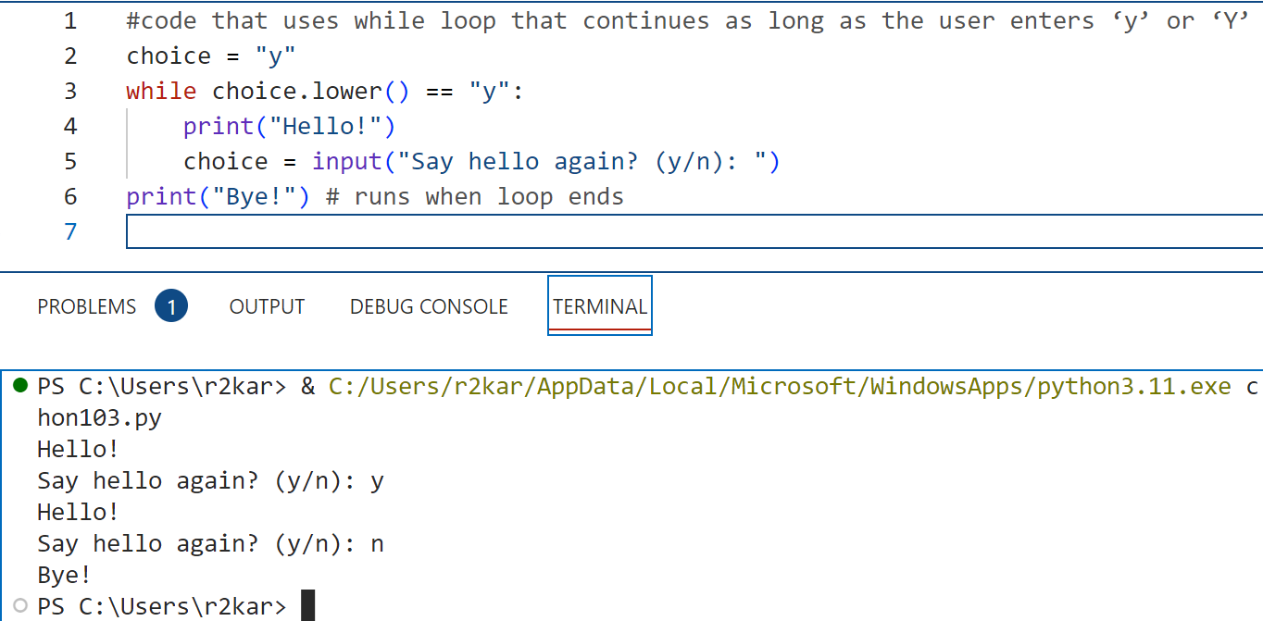
Repetition Structures
Repetition Structures: Example (1) for while Loop
Explanation is in the next slide.

Slide 16
Repetition Structures
Repetition Structures: Example (1) for while Loop
When Python executes a while statement, it executes the statements in the loop while the Boolean expression evaluates to True. Since a while loop uses a condition to determine the number of times it executes, it is known as a condition-controlled loop. The example in the previous slide uses a while loop to continue a program while a user enters “y” or “Y”.
Before the loop, this code creates a variable named choice and sets it to a string of “y”. Then, the loop runs while the choice variable equals “y” or “Y”.

Slide 17
Repetition Structures
Repetition Structures: Example (1) for while loop
The first time through the loop, the choice variable equals “y”. As a result, the loop always runs at least once.
Within the loop, the first statement prints “Hello!” to the console. Then, the second statement asks if the user wants to say hello again and prompts the user to enter “y” for yes or “n” for no. If the user enters “y” or “Y”, the condition at the top of the loop evaluates to True.
As a result, the loop runs again. This prints “Hello!” to the console again. Otherwise, the condition at the top of the loop evaluates to False, and the loop ends. This prints “Bye!” to the console.

Slide 18
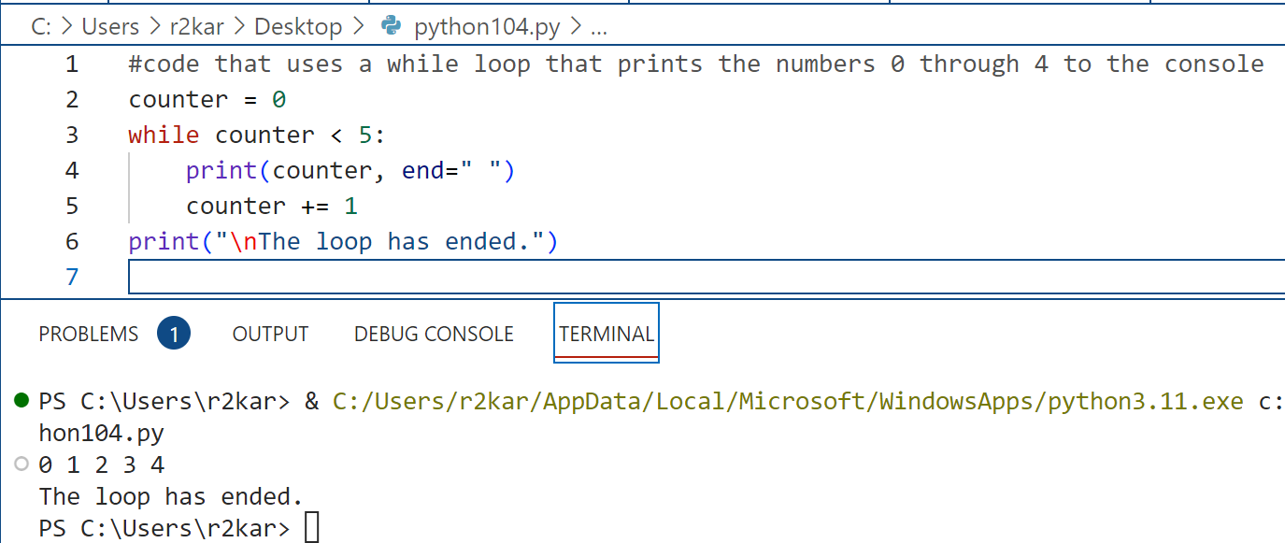
Repetition Structures
Repetition Structures: Example (2) for while Loop
Explanation is in the next slide.

Slide 19
Repetition Structures
Repetition Structures: Example (2) for while Loop
The example in the previous slide uses a while loop to display the numbers 0 through 4.
Before the while statement starts, this code sets a variable named counter to 0. Within the loop, the first statement prints the value of the counter variable to the console followed by a space, and the second statement increases the value of the counter variable by 1.
As a result, each iteration of the loop displays the new value of the counter variable. When that value reaches 5, the condition (less than 5) at the top of the loop evaluates to False, so the loop ends. Then, the first state

Slide 20
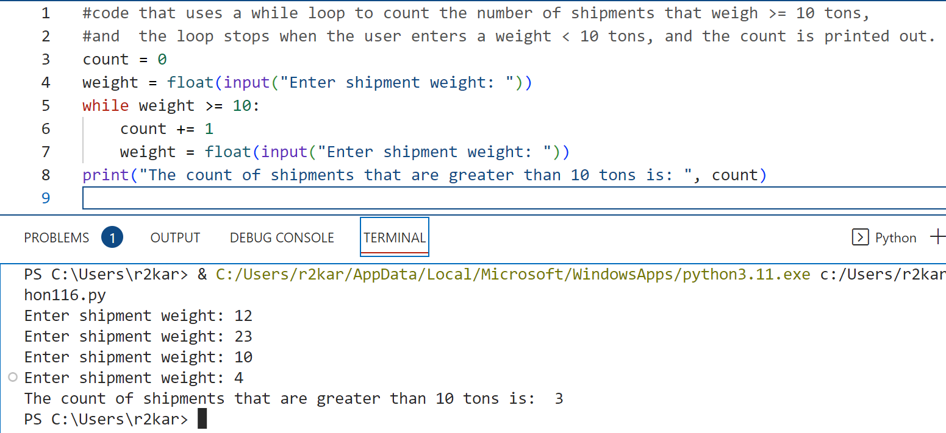
Repetition Structures
Repetition Structures: Example (3) for while Loop
Explanation is in the next slide.

Slide 21
Repetition Structures
Repetition Structures: Example (3) for while Loop
The example in the previous slide uses a while loop to count the number of shipments that weigh greater than or equal to 10 tons.
Before the while statement starts, this code sets a variable named count to 0, then it prompts the user to enter the shipment weight. Within the loop, the first statement increases the value of the counter variable by 1, then it again prompts the enter the next shipment weight.
With this way, the loop keeps going ( prompting the user to enter a new eight and increment the count) until the user enters a weight that is less than 10 tons. The program than exits the loop to print the value of count.

Slide 22
Repetition Structures
Repetition Structures: infinite Loop (you should AVOID it !)
If the condition for a while statement doesn’t ever become False, the loop continues indefinitely. This is called an infinite loop. When you first start programming, it’s common to code an infinite loop by mistake. If you do that, you can use the keystroke combinations (CTRL+C) to end the loop.
Infinite loops usually occur when the programmer forgets to write code inside the loop that makes the test condition false. In most circumstances, you should avoid writing infinite loops.
Look at the example in the next slide that causes an infinite loop.

Slide 23
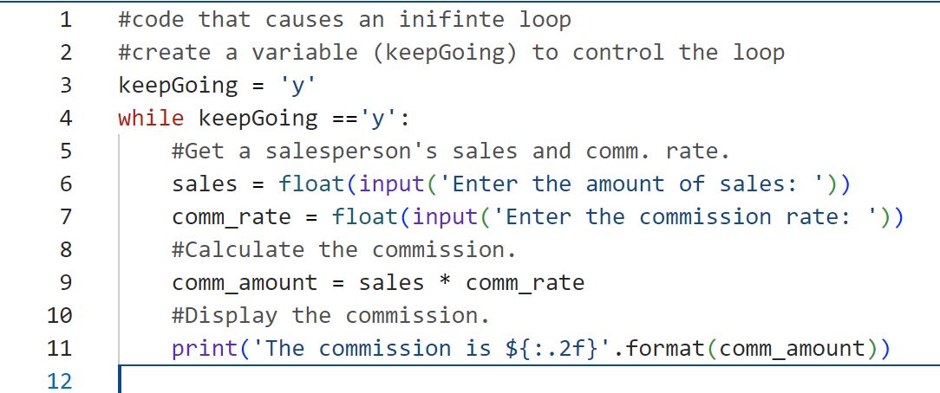
Repetition Structures
Repetition Structures: infinite Loop (you should AVOID it !)
The condition in the While statement (line 4) never gets evaluated to False because the programmer did not update the value of the variable keepGoing inside the loop. As a result, the condition is always True causing the loop to repeatedly run and forever. To stop it, he/she can press a combination of CTRL+C on the keyboard.
* Look at the example in slide 14 for a hint to fix the infinite loop in this problem !

Slide 24
Repetition Structures
Repetition Structures: Do it yourself !
Write a python program that calculates and prints out the area and the perimeter values of a circle. Prompt the user to enter both values in a single input statement separated with ( ; ).
Modify your program so it performs the calculations/prints out for a few circles- prompt the user to enter the number of circles to process.

Slide 25
Repetition Structures
Repetition Structures: Do it yourself !
Write a python program that calculates the value of miles per gallons (mpg) for 5 vehicles. Use a while loop to iterate through the number of the vehicles.
Your program output should look like the following, use format operators:
miles gallons mpg
1 210.0 2.5 ?
2 900.5 13.5 ?
3 515.7 5.1 ?
4 780.8 9.9 ?
5 666.0 5.0 ?

Slide 26
Repetition Structures
Repetition Structures: Do it yourself !
A retail company gives a day off for employees who make more than $10000 in their monthly sales. Write a program in Python that iterates through a number of employees and displays a message “qualifies for a day off” for any employee who does qualify.

Slide 27
Repetition Structures
Repetition Structures: Do it yourself !
Write a Python program that count the number of students who scores greater than 90 in their final exam for a small class of 12 students. The program prompts the user to enter the 12 grades. (Hint: use a counter for the number of the students in the class and another counter that keeps track the number of students with grades > 90).

Slide 28
References
Material has been taken from (can be accessed through Sheridan's Library Services) :
Starting Out with Python (ISBN-13: 9780136912330 ):
https://www.pearson.com/en-ca/subject-catalog/p/starting-out-with-python/P200000003356/9780136912330
Murach’s Python 2nd Edition programming, 2nd Edition :
https://bookshelf.vitalsource.com/reader/books/9781943872756/pages/recent
Introducing Python, Lubanovic, B., O'Reily Media, 2nd Edition, 2019
https://www.oreilly.com/library/view/introducing-python-2nd/9781492051374/

